Slide 1
Arducopter
Embedded Linux
Larry Ferretti

Slide 2
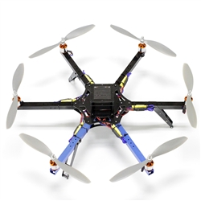
Arducopter Model: Hexa C Maximum height: 11,000 feet Max weight capacity: 4lbs Processor: ARM:2.5

Slide 3
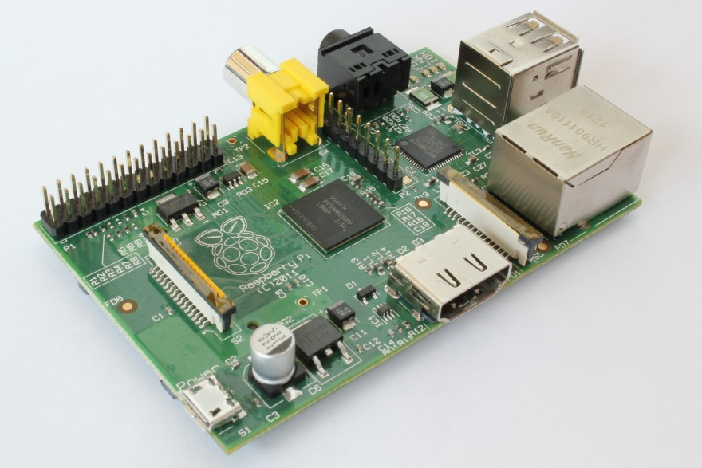


Raspberry Pi Distribution: Raspian What's Running?: Motion Image Capture Open CV

Slide 4
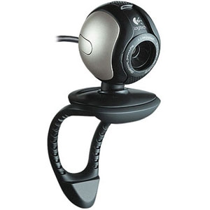
Logitech Webcam 4.0 megapixels Benefits: Low power high capture rate fixed focus lenses

Slide 5
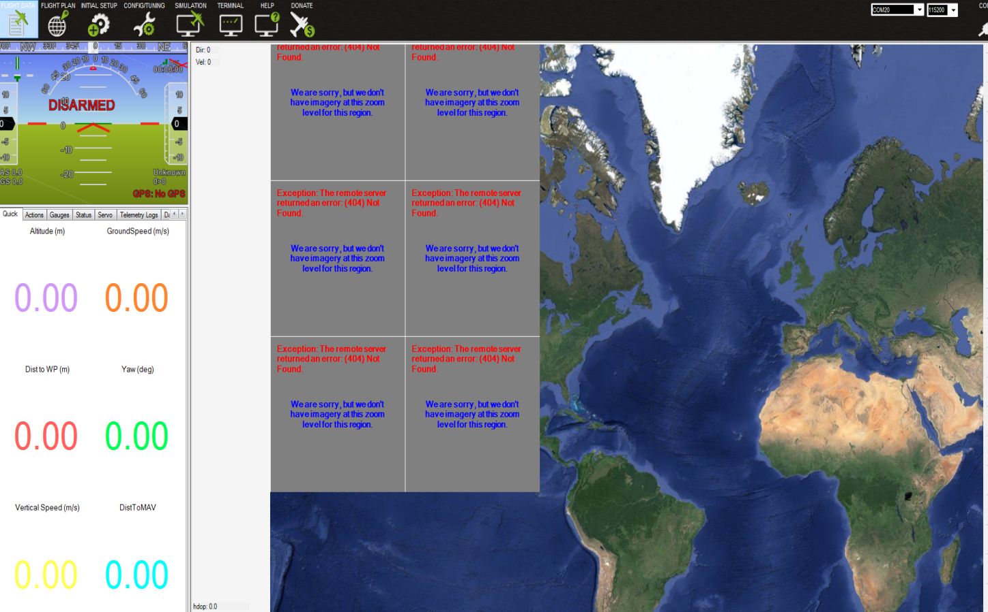
The Setup

Slide 6
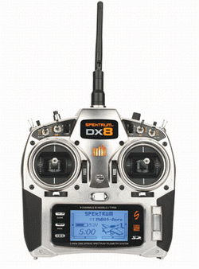
The Remote

Slide 7
The First flight
It makes a very good lawnmower

